Slide 1



Predicting Solar Power Output Using Linear Regression

Slide 2

Learning Objectives
• Understand the application of Linear Regression in solar power prediction.
• Learn how to preprocess and clean a dataset for machine learning.
• Evaluate model performance using different metrics.
• Visualize actual vs predicted results.
GOAL
Source :
www.freepik.com/

Slide 3
Tools and Technology used
• Programming Language: Python
• Libraries: Pandas, NumPy, Scikit-Learn, Matplotlib
• Development Environment: Jupyter Notebook / Google Colab
• Machine Learning Model: Linear Regression

Slide 4
Methodology
1. Data Collection: Solar power dataset containing weather-related features.
2. Data Preprocessing: Handle missing values, normalize data.
3. Feature Selection: Select key predictors of solar power generation.
4. Train-Test Split: 80% training, 20% testing.
5. Train Model: Linear Regression using Scikit-Learn.

Slide 5
Problem Statement:
Solar power generation depends on various environmental factors.
Predicting solar power output accurately helps in energy planning.
How can we use machine learning to improve solar power forecasting?

Slide 6
Solution:
Linear Regression was used to model the relationship between input variables and solar power output.
Feature scaling was applied for better model accuracy.
The model was trained on 80% of the dataset and tested on 20%.

Slide 7
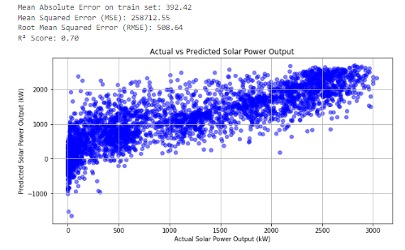
Screenshot of Output: Prediction on train set

Slide 8
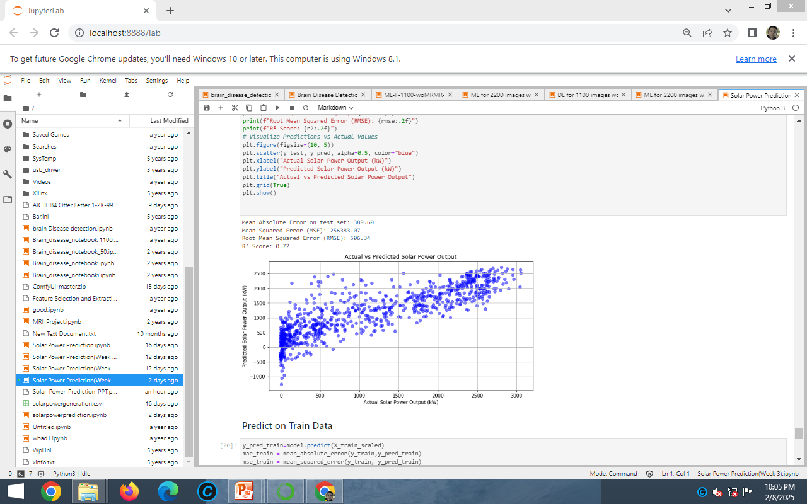
Screenshot of Output: Prediction on test data

Slide 9
Evaluation:
Mean Absolute Error (MAE) - Measures average error.
Mean Squared Error (MSE) - Penalizes large errors.
Root Mean Squared Error (RMSE)** - Square root of MSE.
R² Score** - Measures how well the model explains variance in data.

Slide 10
Conclusion:
• Linear Regression is effective for predicting solar power output.
• Model performance depends on data quality and feature selection.
• Future improvements:
- Use more advanced models like Random Forest or Neural Networks.
- Collect real-time weather data for improved accuracy.
- Optimize model parameters.

